Slide 1
Student name:
BAVISETTI VENKATA SATYA SAI CHITTIBABU
Final Project
3/21/2024 Annual Review

Slide 2
PROJECT TITLE
KEYLOGGER AND SECURITY
3/21/2024 Annual Review

Slide 3


AGENDA
What is keylogging?
How to protect my devices from keylogging?
Examples of a keylogger
Steps to create a keylogger
Hardware keyloggers
Software keyloggers
How to defend keyloggers?
Advantages and disadvantages of keylogging
Conclusion
3/21/2024 Annual Review

Slide 4
What is keylogging?
A keylogger can be special hardware or software that can record keystrokes as you type on a keyboard. You will be able to see passwords and usernames to various accounts (i.e bank accounts, email, etc), google earches, conversations that can be used to extort money or more information from a target, etc. Cybercriminals create fake websites or send an email embedding the keylogger in a malicious link or in a downloadable attachment known as a phishing attack.

Slide 5
Can a keylogger can be detected?
keyloggers can be detected, but the method depends on the type of keylogger:
Hardware keyloggers
These are the easiest to detect by physically inspecting the keyboard circuitry, USB and PS/2 ports, and any hardware additions to the computer. However, they can be dangerous because they can't be detected by security software and can't be installed remotely.
Software keyloggers
These can be more difficult to detect, especially those with rootkit functionality.

Slide 6
Keylogger Types: Hardware vs Software-based
Hardware-based Keyloggers
A hardware-based keylogger is a tiny device, a physical component that connects to the computer via the keyboard. The device usually looks like a standard keyboard PS/2 connector, computer cabling, or a USB adaptor, making it relatively simple to conceal the device for someone who wants to keep an eye on a user’s behavior.
Software-based Keyloggers
A software-based keylogger is a computer program that can be installed without having direct access to the user’s computer. It can be downloaded on purpose by someone who wants to monitor a computer, or it can be downloaded without the user’s knowledge and run as part of a rootkit or a remote administration Trojan (RAT).

Slide 7


PROBLEM STATEMENT
The hacker then analyzes the keystrokes to locate usernames and passwords and uses them to hack into otherwise secure systems.
To tackle this issue we are therefore using a software keylogger that can be remotely ins
3/21/2024 Annual Review

Slide 8

PROJECT OVERVIEW
First we install the python ide and then we install the two packages.
First one is pip pynput install.
Next one is johns library.
Then these two are used for controlling mouse and keyboard.
So we can use for keylogger security.
Above like that you can install it in command prompt.
By these two libraries we cannot get error in python code.
3/21/2024 Annual Review

Slide 9

WHO ARE THE END USERS?
Parents might use a keylogger to monitor a child's screen time.
Companies often use keylogger software as part of employee monitoring software to help track employee productivity.
Information technology departments can use keylogger software to troubleshoot issues on a device.
3/21/2024 Annual Review

Slide 10

YOUR SOLUTION AND ITS VALUE PROPOSITION
Keyloggers are surveillance technology that can record a device's activity and send it to a controlling entity. They can be hardware devices or software, and can be installed on a computer or smartphone. Keyloggers can be difficult to detect because they are designed to be silent and invisible. Here are some ways to protect against keyloggers:
Use security software
Install reputable antivirus and anti-malware software that can help detect and prevent keyloggers. Keep the software up to date to patch vulnerabilities that attackers might exploit.
3/21/2024 Annual Review

Slide 11
Use virtual keyboards
For security-sensitive activities like entering passwords, you can use a virtual keyboard to thwart keyloggers that capture physical keystrokes.
Update your system
Regularly update your operating system, applications, and web browsers to patch vulnerabilities.
Use a firewall
A firewall can help monitor network traffic for suspicious activity. It can also provide strong authentication controls and help protect your data with encryption and access permissions.
To protect yourself from keyloggers:
Use Security Software:
Install reputable antivirus and anti-malware software that can help detect and prevent keyloggers. ...
Keep Software Updated:
Regularly update your operating system, applications, and security software to patch vulnerabilities that attackers might exploit.

Slide 12

THE WOW IN YOUR SOLUTION
To secure accounts in a system or computer.
In this solution the mouse and keyboard control and it store in a txt file what we type on keyboard.
3/21/2024 Annual Review
‹#›

Slide 13
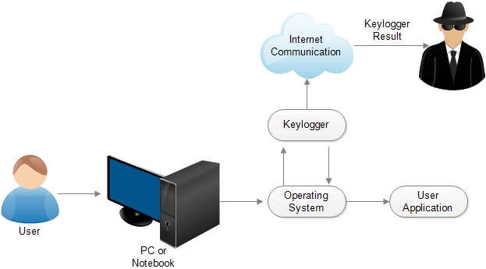
MODELLING
Teams can add wireframes
3/21/2024 Annual Review
‹#›

Slide 14
RESULTS
The process of developing a keylogger from scratch, emphasizing ethical use and legal considerations. It covers all critical aspects from implementation to deployment and analysis, ensuring a comprehensive approach to keylogging for legitimate purposes.
3/21/2024 Annual Review
‹#›

Slide 15
https://github.com/Chittibabu14/chitti_project.git

Slide 16
THANK YOU

